Slide 1
Understanding and Using Terminology in HL7 FHIR
Rob Hausam MD
HL7 Working Group Meeting
Madrid, Spain
10 May 2017

Slide 2
This presentation
Can be downloaded here:
http://gforge.hl7.org/svn/fhir/trunk/presentations/2017-05%20Tutorials/FHIR%20Terminology.pptx
Use “anonymous” and email address to logon
Is licensed for use under the Creative Commons, specifically:
Creative Commons Attribution 3.0 Unported License
(Do with it as you wish – just give credit)
Acknowledgements: Grahame Grieve, Lloyd McKenzie

Slide 3
Who am I?
Name: Rob Hausam MD
Company: Hausam Consulting LLC
Background:
Co-chair of Vocabulary and Orders and Observations WGs
FHIR Core Team member and Terminology Module editor
Actively involved in HL7 and terminology standards/development and modeling for 15+ years

Slide 4
Who are you?
Who is familiar with:
V2
V3
CDA
FHIR
SNOMED CT
LOINC
ICD
Background
Technical (e.g. developer, architect)
Clinical (e.g. physician, nurse, pharmacist)
Non-technical (e.g. manager, CEO)

Slide 5
Tutorial Objectives
Examine how coded data is shared in FHIR
Understand code system and value set definition and use in FHIR
Understand terminology binding in FHIR
Understand FHIR terminology-based searching capabilities
Explore the capabilities and use of FHIR Terminology Services

Slide 6
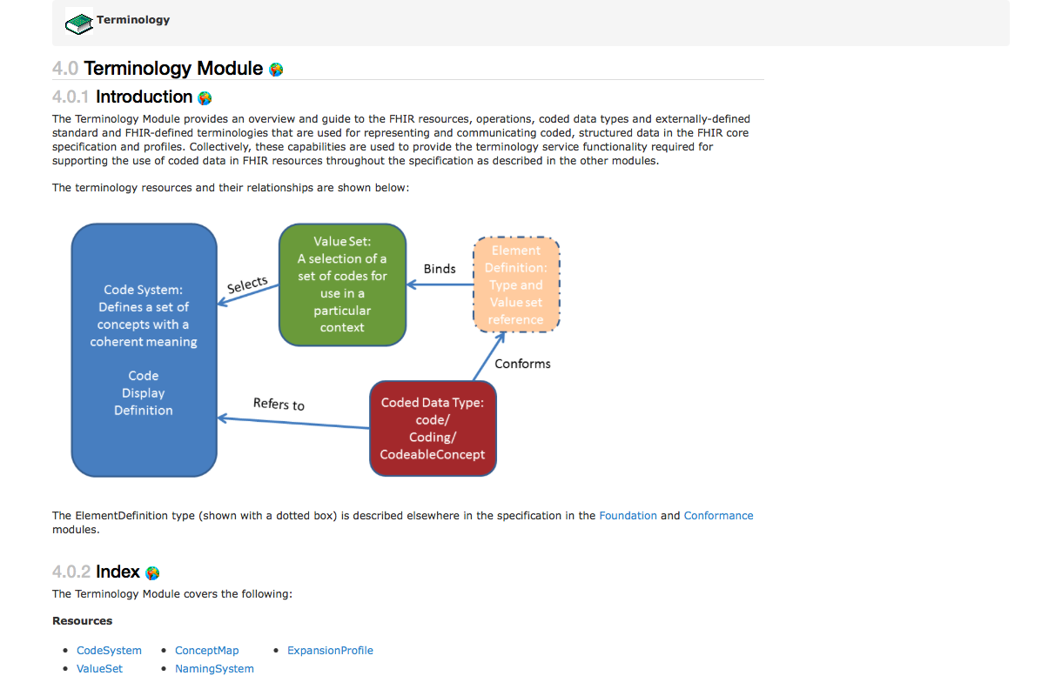
Terminology Module
http://hl7.org/fhir/STU3/terminology-module.html (STU3 - 3.0.1)

Slide 7
Sending Coded Data

Slide 8
Terminology Sub-system: Code System
Code System:
Defines a set of concepts with a coherent meaning Code Display
Definition
SNOMED CT / LOINC / ICD-10
HGVS, ICPC, CPT, NUCC, MIMS, ANZSCO, METeOR (+ 100s more)
HL7 V2 tables, V3 code systems
A drug formulary
A config table in an application
A list of enums in a java class
Country codes

Slide 9
Terminology Sub-system: Value Set
Code System:
Defines a set of concepts with a coherent meaning Code Display
Definition
Value Set:
A selection of a set of codes for use in a particular context
Selects
“European country codes”
“The LOINC codes I use”
All LOINC order codes
A SNOMED CT hierarchy

Slide 10
Code System vs. Value Set
Often mixed in common usage
E.g., an application table that mixes LOINC codes and custom (self-defined) codes
E.g., the only way to know it’s a LOINC code is if it has the distinctive NNN-N syntax
Keep your definitions clean, or you’ll get in trouble when you exchange data
Separate the definition (code system) and use (value set) of a concept

Slide 11
Terminology Sub-system: Binding
Code System:
Defines a set of concepts with a coherent meaning Code Display
Definition
Value Set:
A selection of a set of codes for use in a particular context
Element Definition Type and Value Set reference
Binds
Selects

Slide 12
Bindings
Bindings identify what sort of codes are allowed for a given element
Can be:
Value set
Defined set of codes from 1..* code systems
Reference (to an “inferred” value set)
E.g. Mime types
Description only
Must be populated if no reference is available

Slide 13
Binding Strength
required: You must use the specified codes
Or omit the element if no code applies for the concept
extensible: You must use the specified codes if they apply
Free to use other codes or text if value set doesn’t cover concept
preferred: You SHOULD use the specified codes
But if you have a good reason, you can use something else instead – not required to be conformant
example: These codes just give an idea of what you might use
No expectation (or recommendation) of use

Slide 14
Terminology Sub-system: Coded Data
Code System:
Defines a set of concepts with a coherent meaning Code Display
Definition
Value Set:
A selection of a set of codes for use in a particular context
Element Definition Type and Value Set reference
Binds
Selects
Conforms
Element:
(Coded Data Type) code/ Coding/ CodeableConcept
Refers to

Slide 15
Referring to a code system
Each “use of a code” (a reference into a code system) has 4 properties:
system: URL of the code system
version: stated version of the code system (optional)
code: the symbol defined for the concept (code/expression)
display: a human readable representation of the concept (optional – debugging/display)

Slide 16
URL vs. OID
In v2, you could identify code systems (and identifier systems) in a variety of ways
typically a local string
In v3 you had to use OIDs
E.g. 2.14.1237.937.25.58
In FHIR, we use URLs
E.g. http://myhospital.org/codes/labresults
Can also use urn:oid:2.14.1237.937.25.58
But why would you want to? ☺
Human-readable
Potentially resolvable
No training required

Slide 17
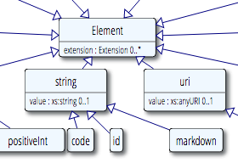
The ‘code’ Data Type
Just a code
Code system is fixed
Value set is fixed (required binding)
Display name is known
Used for “structural” elements
Essential to fundamental interoperability
Reasonable to standardize at international level
E.g. status, Bundle.type, etc.

Slide 18
What if I need a different ‘code’?
‘code’ data elements aren’t extensible
Can’t send your own custom codes
If coded element is optional
Omit the element and just send an extension
If coded element is minOccurs=1
Choose the code closest matching your need
Send additional semantics as an extension
Consider submitting a change request for inclusion in a future version of FHIR

Slide 19
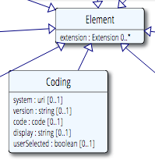
Coding
code + system
Not often used directly
Example: Consent.securityLabel
In most cases, if you need one coding, you probably need translations and/or original text ➔CodeableConcept
Why is everything optional?

Slide 20
Coding – Element Optionality
Version, display and userSelected provide additional optional information
Only the code is known (and not the system)
Rare, and best avoided
Must be able to infer the system by context or no useful processing can be performed
System is present with no code
Means there is no suitable code in the system which can be used to represent the concept

Slide 21
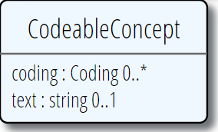
CodeableConcept
All codings are “equal”
One can be “user selected”
Coding.userSelected (boolean)
To maximize interoperability, send what codings you know
Text: Representation of the concept as entered or chosen by the user
Text and Coding.display are fallbacks for systems that don’t recognize your code, so good practice to include them

Slide 22
What to use in an extension?
Default is CodeableConcept – it’s safest for subsequent migration and interoperability
Use Coding only if translations don’t make sense (not just if you don’t currently have a need)
Use ‘code’ if:
Essential that everyone use the same codes
You can define a set of codes that cover the space

Slide 23
Codes vs. Identifiers
Coding
Identifier
code
system
display (for code), version, primary, valueSet
Represents meaning/concept
Can cover real things such as countries, states
value
system
label (for system), use, period, assigner
Represents “identity”, but can identify a “kind”

Slide 24
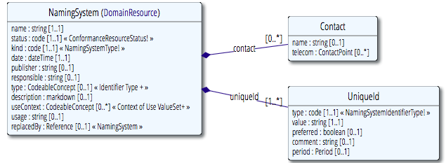
NamingSystem resource
Defines both code systems and identifier systems
Allows mapping between OIDs, URLs, etc.

Slide 25
Code System vs. Value Set (again)
Code systems define symbols with specific meanings
E.g. LOINC, SNOMED, ICD-10, IETF language codes, local lab result codes, etc.
Value sets define collections of codes for use in a particular context
E.g. Codes for vital signs, codes for procedures
Can come from a single code system or multiple code systems

Slide 26
CODE SYSTEMS

Slide 27
CodeSystem resource
Declare the existence of a code system and its key properties:
Identifying URL and version
Description, copyright, publication date, and other metadata
Whether case sensitive and version safe
Whether a compositional grammar is defined
Filters for use in a ValueSet.compose element
Code system-defined concept properties

Slide 28
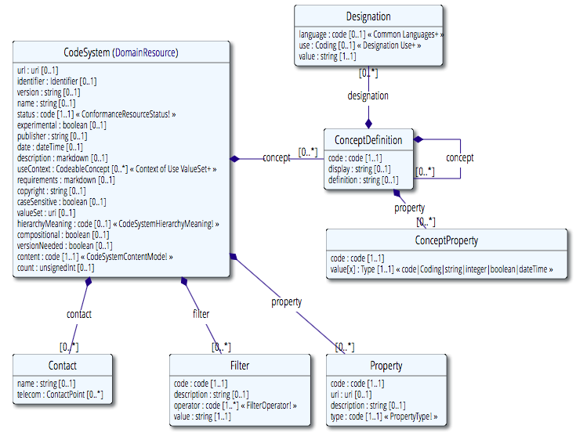
Value Set
Previously was part of ValueSet resource prior to STU3

Slide 29
CodeSystem resource
May list some or all of the concepts in the code system, along with their basic properties (code, display, definition), designations, and additional properties
Not intended to support the process of maintaining a code system
Not intended for distributing important existing (large) code systems (SNOMED CT, LOINC, RxNorm, ICD family, etc.)

Slide 30
Defining Concepts
All code systems have a URL
Code + definition
Primary representation
Multiple other representations
Alternate languages, alternate uses

Slide 31
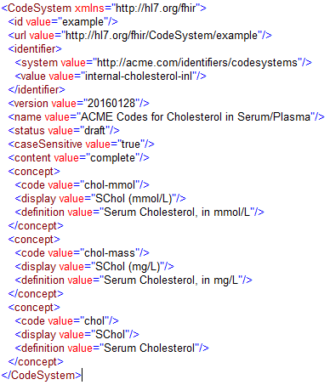
Code system definition example

Slide 32
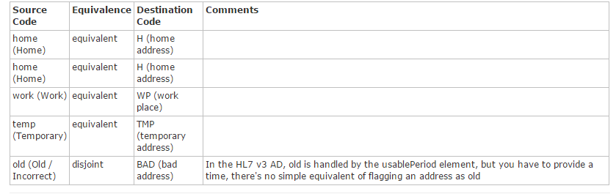
ConceptMap resource
A list of mappings between concepts from two different code systems or models

Slide 33
Value Sets

Slide 34
ValueSet resource
Value sets use CodeSystem resources by referring to them via their canonical URLs
Value sets are used in ElementDefinition and Questionnaire resources to specify the allowable contents for coded elements

Slide 35
ValueSet resource
Modeled on OMG CTS 2 functionality (subset)
ValueSet resources can be converted to CTS2 value sets
Aligned with Value Set Definition (VSD) spec
Not all VSD elements are in the base resource
Some are defined as part of ValueSet extensions
The ‘compose’ element represents the VSD "Content Logical Definition” (CLD)

Slide 36
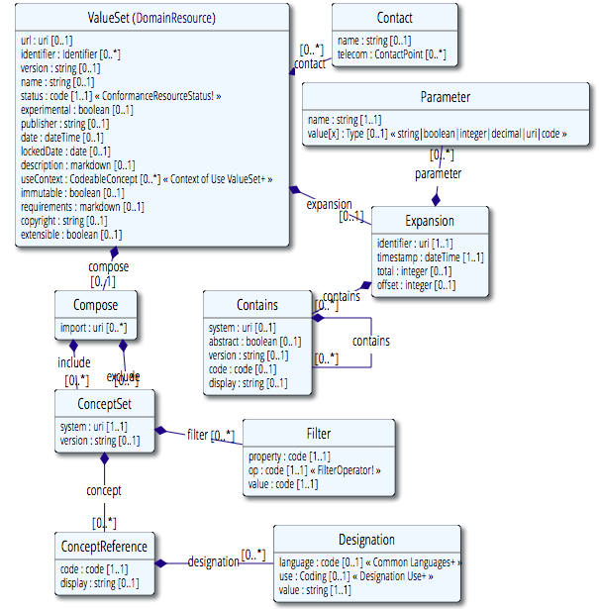
Value Set

Slide 37
Value Set Parts
Meta data
Logical definition (.compose):
Other value sets to include
Codes to include/exclude – system, list or by filter
Expansion (.expansion)
What’s actually in the value set today, under local conditions

Slide 38
Versions
Versions are important to understand and use, when needed
A value set that doesn’t use ValueSet.compose.include.version has unknown content, even if it lists the codes explicitly
If you don’t decide on a version, the decision and the results are delegated to run time
But this is a very common thing to do

Slide 39
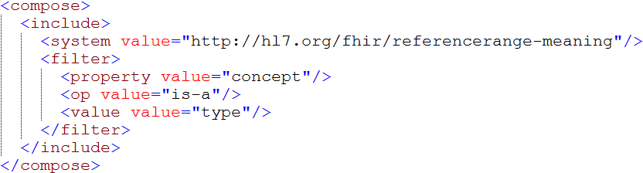
Compose example

Slide 40
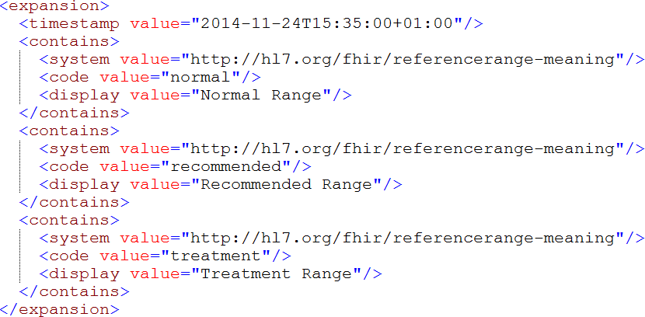
Expansion example

Slide 41
Selecting Concepts
Name the System (optional: version)
If just a system, then all codes are included
List codes
Can provide alternate descriptions
Select codes by property
Name – defined by the code system
Operation – equals, in, regex, etc
Value – the value of the property
E.g. LOINC: ORDER_OBS = Order

Slide 42
Terminology-based Search

Slide 43
Search parameters
Token
Exact match: system|code
http://test.fhir.org/r3/Condition?code=http://snomed.info/sct|425144005
Code, any system: code
http://test.fhir.org/r3/Condition?code=425144005
Code, no system: |code
http://test.fhir.org/r3/Condition?code=http://snomed.info/sct|

Slide 44
Search parameters
Modifiers
Search on CodeableConcept.text or Coding.display or Identifier.type.text: text
http://fhirtest.uhn.ca/baseDstu3/Condition?code:text=angina
Exclude resources that match based on token (previous slide): not
http://test.fhir.org/r3/Condition?severity:not=255604002

Slide 45
Search parameters
Value Set-based Modifiers
Code in value set: in
http://fhirtest.uhn.ca/baseDstu3/Condition?code:in=http://hl7.org/fhir/ValueSet/condition-code
Code not in value set: not-in
http://fhirtest.uhn.ca/baseDstu3/Condition?code:not-in=http://hl7.org/fhir/ValueSet/condition-code

Slide 46
Search parameters
Subsumption-based Modifiers
Code in a resource subsumes the specified search code (e.g. is-a* relationship): below
http://fhirtest.uhn.ca/baseDstu3/Condition?code:below=http://snomed.info/sct|233604007
Code in a resource is subsumed by the specified search code (e.g. is-a* relationship): above
http://fhirtest.uhn.ca/baseDstu3/Condition?code:above=http://snomed.info/sct|233604007
*is-a relationship includes the code itself

Slide 47
Terminology SERVICE

Slide 48
Terminology Service Rationale
There’s a lot of complexity here:
Code Systems
Value Sets
Bindings
Many (or most) applications are much simpler
List of codes and displays in some table structure
This is a known problem

Slide 49
Terminology Service Rationale
Delegate the complexity to specialist software
Provide a set of services that do what applications need
It becomes easy to write applications that do terminology well

Slide 50
Application Needs
Give me a list of codes
Is this code valid?
How do I display a code?
Translate this code to a different code system
Integrate terminology search into my application

Slide 51
Terminology Service Operations - Overview
$expand – given a value set, get the current expansion (code set)
$lookup – given a code & system, what are the additional details (e.g. definition, status, designations, properties, subproperties)?
$validate-code – is this code a valid member of the value set?
May include subsumption testing for intensionally defined (e.g. subsumption-based) value sets

Slide 52
Terminology Service Operations - Overview
$translate – can you translate this code to another code system?
$closure – maintain a closure table for me (the client)

Slide 53
Terminology Service Operations – New in STU3
$subsumes – is the code "sub" subsumed by the code "super”?
Based on the code system semantics
$compose – given a set of properties, return one or more possible matching codes
Replaces “$infer” – since Baltimore WGM September 2016

Slide 54
$expand
Takes in a value set and returns the value set containing the expansion as of “now”
http://....ValueSet/someId$expand
http://...ValueSet$expand?identifier=[someURL]
http://...ValueSet (pass ValueSet in body)
Some additional parameters include:
filter: Only include concepts with display name containing string
date: Generate as of the specified date

Slide 55
$expand
Expansion profile (or equivalent parameters):
profile: URI, which may refer to an ExpansionProfile resource (or possibly an implementation-specific profile mechanism)
Multiple input parameters are available which can specify constraints which are equivalent (and potentially an alternative) to the ExpansionProfile resource (see next slide for the ExpansionProfile resource)

Slide 56
$expand example
http://test.fhir.org/r3/ValueSet/condition-category
http://test.fhir.org/r3/ValueSet/condition-category/$expand

Slide 57
$validate-code
Takes a code/Coding/CodeableConcept and checks if it’s valid against a value set
Specify value set (same as for $expand)
Code to validate
code+system (with or without version, display), Coding or CodeableConcept
date – date to validate as-of
Outputs: true/false
message if not valid, display names if valid

Slide 58
$validate-code example
http://test.fhir.org/r3/ValueSet/condition-category/$validate-code?system=http://hl7.org/fhir/condition-category&code=problem-list-item

Slide 59
$lookup
Takes a code+system(version)/Coding and returns additional details about the concept
Name, version, preferred display string, properties (including subproperties) and designations (additional representations for the concept)
Some additional parameters include:
property: Only include concepts with display name containing string
date: return information as of the specified date

Slide 60
$lookup example
http://test.fhir.org/r3/CodeSystem/$lookup?system=http://snomed.info/sct&code=233604007

Slide 61
$subsumes
Test whether codeA/codingA ("sub”) is subsumed by codeB/codingB ("super”)
Based on the semantics of subsumption in the underlying code system (e.g. SNOMED CT)
Returns one of four possible codes:
equivalent, subsumes, subsumed-by, and not-subsumed
If unable to determine the relationship between codes, returns an error

Slide 62
$subsumes example
http://its.patientsfirst.org.nz/RestService.svc/Terminz/CodeSystem/$subsumes?system=http://snomed.info/sct&codeA=3738000&codeB=235856003
http://its.patientsfirst.org.nz/RestService.svc/Terminz/CodeSystem/$subsumes?system=http://snomed.info/sct&codeB=3738000&codeA=235856003

Slide 63
$translate
Uses concept map to translate code
http://...ConceptMap/id$translate
code, Coding or CodeableConcept passed (as per $validate-code)
Output:
True if can be translated
Message if can’t be translated
Translated coding if it can be translated

Slide 64
Some Available Terminology Servers
Health Intersections (Grahame Grieve’s)
http://test.fhir.org/r3
OntoServer (CSIRO - Australia)
http://ontoserver.csiro.au/stu3-latest
Terminz (Patients First – New Zealand)
http://its.patientsfirst.org.nz/RestService.svc/Terminz/

Slide 65
Some Useful Tools
clinFHIR (David Hay)
CodeSystem builder
http://clinfhir.com/codeSystem.html
ValueSet explorer
http://clinfhir.com/valuesetCreator.html
Query Tool
http://clinfhir.com/query.html
Postman
https://www.getpostman.com/

Slide 66
More Questions?
FHIR Zulip chat terminology stream
https://chat.fhir.org/#narrow/stream/terminology
Rob Hausam
rob@hausamconsulting.com

Slide 67
BONUS TOPICS

Slide 68
Bonus Topics (time and interest permitting)
Implicit value sets
$compose
$closure
Expansion Profile

Slide 69
Implicit Value Sets
Implicit value sets are those whose specification can be predicted based on the grammar of the underlying code system, and the known structure of the URL that identifies them
Example - SNOMED CT has two common sets of implicit value sets defined:
By Subsumption
By Reference Set

Slide 70
Implicit Value Sets (cont.)
Implicit value sets do not use complex queries
Allows a single URL to serve as a value set definition that defines a value set, and can serve as the basis for the $expansion operation

Slide 71
Implicit Value Set $expand Example URL
http://test.fhir.org/r3/ValueSet/$expand?url=http%3A%2F%2Fsnomed.info%2Fsct%3Ffhir_vs%3Disa%2F233604007

Slide 72
$compose
Given a set of property/concept pairs, return the set of concept(s) that match those properties
Example use:
SNOMED Composition - provide multiple properties, and ask for a single pre-coordinated code that represents the whole

Slide 73
Closure – why do we need it?
Find any observations for male patients over the age of 50 who attended a particular clinic within a particular 2 week period, with a diagnosis of gout, and who had an elevated serum creatinine
Some of this is terminology based, some isn’t
How do you make this work?

Slide 74
Closure – the problem and the FHIR approach
Both "diagnosis of gout" and "serum creatinine" involve value set and/or subsumption queries (against SNOMED CT and LOINC respectively)
Generate a subsumption closure table on the fly, as new codes are seen
Terminology server does terminological reasoning
Client does closure table maintenance

Slide 75
$closure
For every new code encountered by the client in a context
Ask the server what relationships exist with codes already in that context
Put them all in a ‘closure’ table
Concept table (key : system : code : display)
Closure table (keySource, keyDest)
Can include joins on this table as part of other queries

Slide 76
Expansion Profile resource
Defines constraints on the expansion of a value set in FHIR (ValueSet resource)
Include or exclude specified code systems
Include or exclude designations, including designations for specific languages or uses
Include or exclude definitions, inactive concepts, “nested” codes, “not to be rendered in user interface” codes, post-coordinated expressions
Specify display language for the expansion
Allow limited expansion for too large value sets

Slide 77
Expansion Profile (cont)
Elements (parameters):
includeDesignations
includeDefinition
includeInactive
excludeNested
excludeNotForUI
excludePostCoordinated
displayLanguage
limitedExpansion

